Slide 1
The Project Infrastructure
Chapter 03
ISYS663
Leigh Jin

Slide 2
Learning Objectives
Define project integration management and describe its role in project planning, execution, and change control.
Describe the five project management processes
Understand product-oriented processes and how they are used to implement the Systems Development Life Cycle (SDLC).
Understand how to develop a project charter
Identify the steps in the project planning framework and understand how the project’s measurable organizational value (MOV) is linked to the project’s scope, schedule, and budget.

Slide 3
Project Integration Management
In the project management context, Project Integration Management entails making choices about resource allocation, making trade-offs among competing objectives and alternatives, and managing the interdependencies among the project management Knowledge Areas.

Slide 4
Project Integration Processes
Develop Project Charter
Develop Project Management Plan
Direct and Manage Project Execution
Monitor and Control Project Work
  Corrective actions
  Preventive actions
  Defect repair
Perform Integrated Change Control
  Through the entire project life cycle
  Document, review and decide about changes
  Update the project management plan
Close Project or Phase

Slide 5
The Business Case has been approved, but…
Who is the project manager?
Who is the project sponsor?
Who is on the project team?
What is the scope of the project?
How much will the project cost?
How long will it take to complete the project?
What resources and technology will be required?
What approach, tools, and techniques will be used to develop the information system?
What activities will be required to perform the project work?
How long will each of these activities take?
Who will be responsible for performing these tasks or activities?
What will the organization receive for the time, money, and resources invested in this project?

Slide 6




PMBOK - Definition
Process
  A set of interrelated actions and activities performed to achieve a pre-specified product, result, or service

Slide 7


Projects versus Processes
Processes are ongoing
    If you’re building cars on an assembly line, that’s a process!
    If you’re designing and building a prototype of a specific car model, that’s a project!

Slide 8
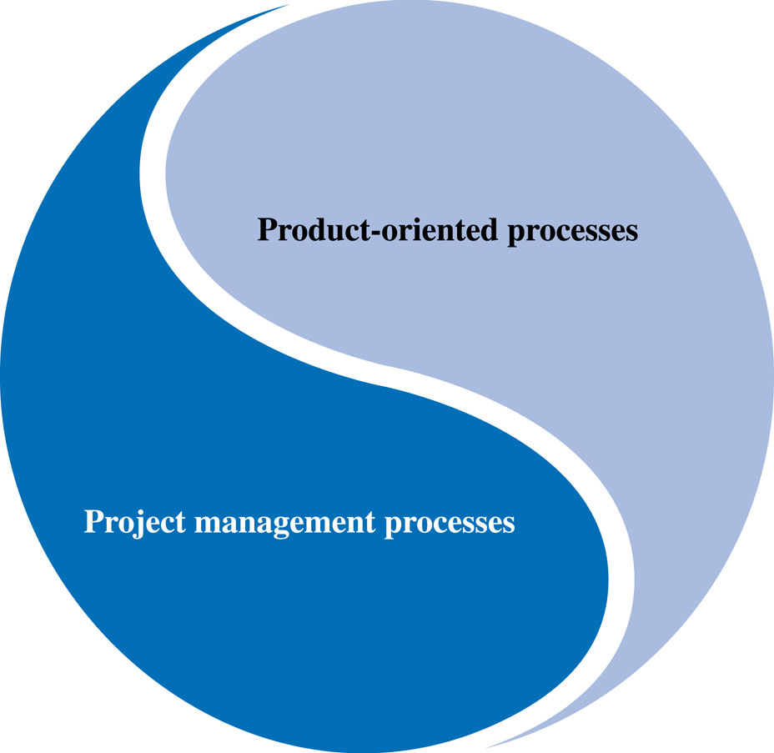
Project Management Processes
Project vs. Product Management processes
Figure 3.1

Slide 9
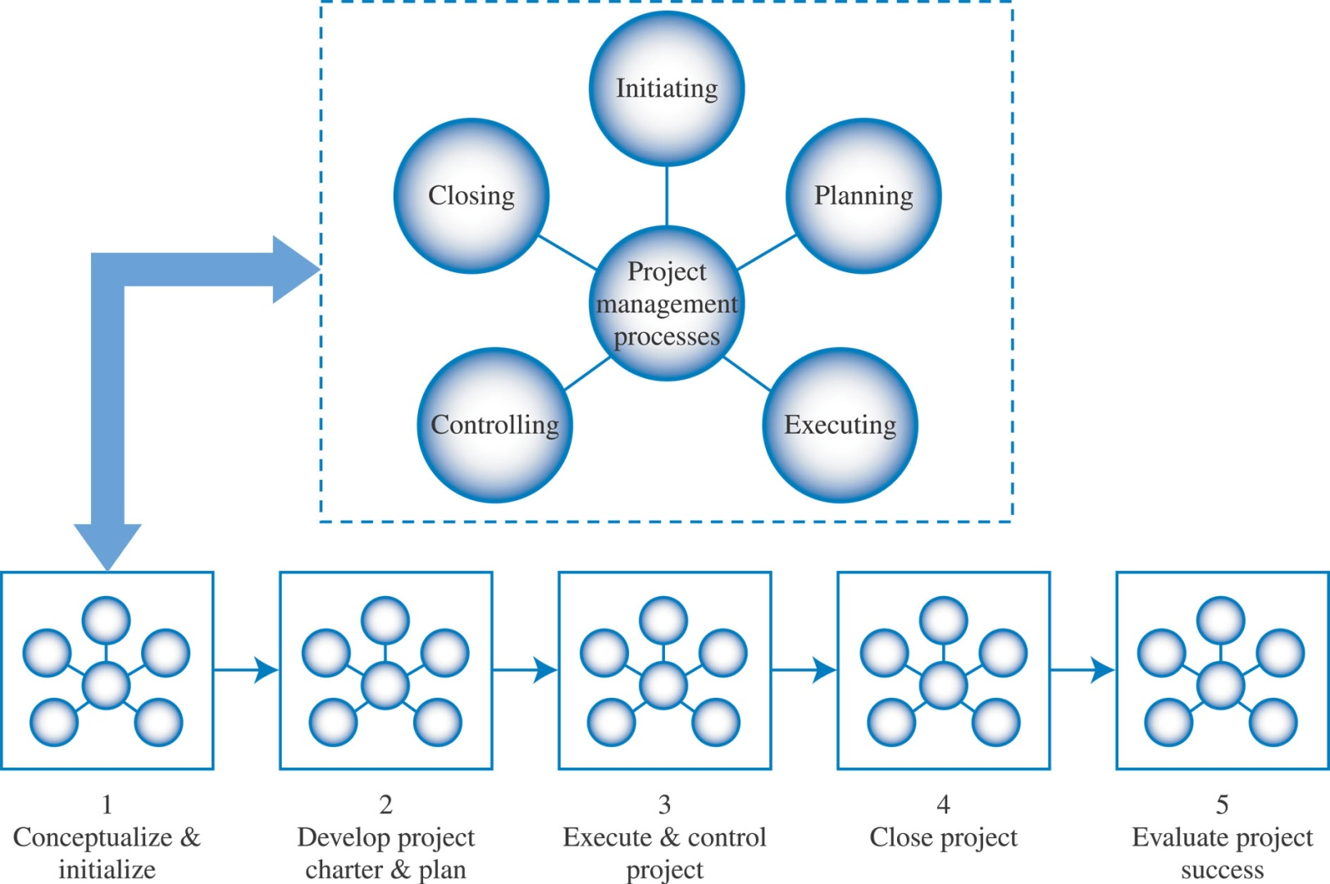
Project Management Processes and ITPM Phases
Figure 3.2
process groups overlap within and between the phases of the project

Slide 10
Project Management Process Groups
  Initiating
    Signals the beginning of the project or a phase
  Planning
    Supports planning of the entire project and each individual phase
  Executing
    Integrate people and resources to carry out the planned activities of the project plan or phase
  Monitoring and Controlling
    Manage and measure progress towards the project’s MOV and scope, schedule, budget, and quality objectives.
    Manage and measure project variances between actual and planned results so that appropriate corrective actions can be taken.
  Closing
    Provides a set of processes for formally accepting the project’s product, service, or end result

Slide 11
Product-Oriented Processes
Defines how the Systems Development Life Cycle (SDLC) will be implemented.
This will then define all of the sub-phases and deliverables associated with the Execute and Control project management life cycle phase.

Slide 12
Implementing the SDLC
Implementation method will depend on the size and complexity of the project as well as the experience and skills of the project team.
This will be a critical factor for developing the project plan in terms of project phases, deliverables, tasks, and resources that will be used to estimate the project’s schedule and budget.
Can use a structured development approach or an iterative development approach.

Slide 13
Structured Development Approach
The Waterfall Model was developed as a simple and disciplined method for systems development.
Stresses a sequential and logical flow of software development activities.
Detailed planning makes estimating easier.
More suitable for large, complex systems.
May also work well when the project team is less experienced or less technically competent .

Slide 14
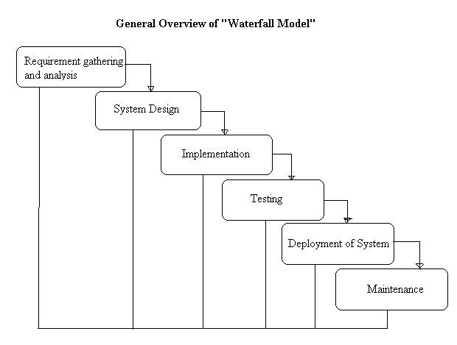

Slide 15
Iterative Systems Development
Shortening the SDLC
Understand that requirements are difficult to define and will change over time.
Emphasizes using working software to measure progress.
Relies heavily upon face-to-face communication.
Allocate a box of time (2 weeks) for each iterative cycle

Slide 16
Iterative Approaches to Systems Development
Rapid Application Development
  Compress the analysis, design, build, and test activities of the SDLC into a series of short iterations or development cycles.
  e.g. only handle 25% of the requirement instead of 100%
Prototyping
  A prototype may be developed to discover or refine system requirement specifications.
  e.g. develop a nonfunctional or partially functional user interface to help understand the user requirement

Slide 17
Iterative Approaches to Systems Development
Spiral Development
  Breaks up a software project into a number of miniprojects that address one or more major risks.
  Identifies risks as each iteration is completed.
Agile Systems Development
  SCRUM, Dynamic Systems Development Method (DSDM), Adaptive Software Development (ASD), eXtreme Programming (XP).
  Releases are developed through several iteration.
  Each working release is transferred to users.

Slide 18
The Project Charter
Serves as an agreement or contract between the project sponsor and team
Provides a framework for project governance

Slide 19
The Project Charter
Documents the project’s MOV
Defines the project infrastructure
  People, resources, technology, methods
Summarizes the details of the project plan
  Scope, schedule, budget, quality objectives, deliverables, and milestones
Defines roles and responsibilities
  Project sponsor, project manager, and project team
Shows explicit commitment to the project
Sets out project control mechanisms
  Define how to request and respond to proposed change

Slide 20
What Should Be in a Project Charter?
Project ID
Project Stakeholders
Project Description
MOV
Project Scope
Project Schedule (summary)
Project Budget (summary)
Quality issues/standards/requirements
Resources
Assumptions & Risks
Project Administration
Acceptance and Approval
References
Terminology (acronyms and definitions)

Slide 21
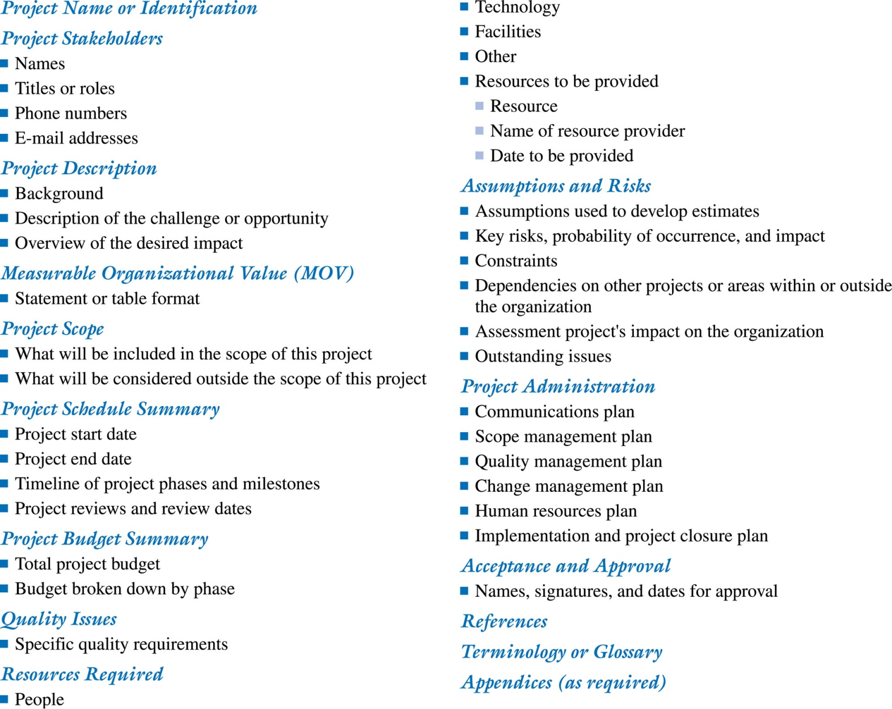
Project Charter Template

Slide 22
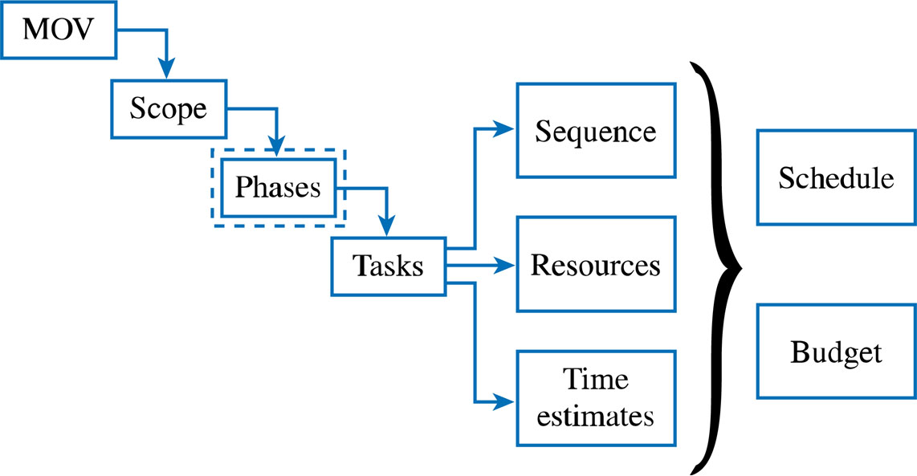
Project Planning Framework
Figure 3.4

Slide 23
Project Planning Framework
The MOV
Define the Project’s Scope
  Initiation
  Planning
  Definition
  Verification
  Change Control

Slide 24
Project Planning Framework
Subdivide the Project into Phases
  Each phase should define deliverables and milestones
Tasks-Sequence, Resources, and Time Estimates
  Tasks: activity or unit of work to be completed
  Sequence: tasks may be linear or parallel
  Resources: technology or people, determine project cost
  Time: a specific amount of time it takes to complete a task
Schedule and Budget-The Baseline Plan

Slide 25
The Kick-Off Meeting
Officially starts the work on the project
Brings closure to the planning phase
Communicates to all what the project is about
Energizes stakeholders
Engenders positive attitudes

